Slide 1
AI vs. Human in Customer Service
Yan Ping Yu,

Slide 2
Story about ..
I have a friend who runs a curated branding business……
Notes:
I have a friend who runs a curated branding business, which disrupts the traditional self-produced branding businesses by providing a more affordable price for luxury products, and was willing to lend out her platform to test the customer service system. The business runs with a “order now, buy later” process, which has a high demand for customer service, especially when products need to be sourced from different countries at the best price. As a huge fan of luxury brands, one of our biggest challenges is to find a cheapest alternative to our interested products. However, often even after receiving help from a designated customer service agent, we still struggle with getting an accurate and quick response. After learning about artificial intelligence and its automation capabilities, I decided to discover more on whether an automated customer service system could improve efficiency.
In the “Featured Brands model”, popular products from major brands are displayed on the website. After placing an order, the product is manually purchased and shipped from the country with the lowest price. As there is a fixed availability for popular products, customer inquiries and purchases are predictable. A potential for increased efficiency and subsequent purchase rate prompted us to develop an automated customer service system.

Slide 3
Statement of the Problem

Slide 4
Problem 1 :
Manual customer service is capital intensive due to the high workload to frequently replace and update the large variety of products.

Slide 5
Problem 2 :
When the service personnel is offline, consumers can only wait when they face a problem.

Slide 6
Problem 3 :
The automated online customer service can provide order statistics to respond to after-sales service and answer product-related questions. If the latter is performed manually, it is difficult to achieve 100% accuracy, and there will be unavoidable operational errors in this highly repetitive process.

Slide 7
Research Questions,
Hypotheses, and Effects

Slide 8

1.
Compared to traditional human customer service, does the
application of the customer service chatting bot save more average
waiting response time for the users?

Slide 9

2.
Compared to traditional human customer service, does the
application of the customer service chatting bot decline the
error rate for resolving customer cases?

Slide 10

3.
Compared to traditional human customer service, does the application
of the customer service chatting bot reduce the average time for
resolving customer issues?

Slide 11
Importance of the Study
and Social Impact

Slide 12
Organizational leadership effectiveness of automated customer service systems.
How the findings could lead to more efficient, cost-less customer service models in similar industries.
Broader discussion about the role of AI and automation in customer service transformation
Notes:
Organizational leadership effectiveness of automated customer service systems.
How the findings could lead to more efficient, cost-less customer service models in similar industries.
Broader discussion about the role of AI and automation in customer service, providing valuable data for other businesses considering similar transformations.

Slide 13
Research Plan

Slide 14
Population
of
Interest
Sample
Selection
Sample
Size
Operational
Procedure
Data
Collection
Variables
All of the company’s online potential buyers and existing customers.

Slide 15
Sample
Selection
Population
of
Interest
Sample
Size
Data
Collection
Operational
Procedure
Variables
Inclusion Criterion:
Individuals who purchased products or expressed interest in a purchasing agent's product online.
Exclusion Criteria:
Lack of interest
Technical issues
Study Subject Groups:
Participants divided based on primary interaction type.
Control Group: traditional human customer service.
Treatment Group: automated customer service bot.
Notes:
The inclusion criterion will be individuals who have purchased products or expressed interest in a product of a purchasing agent online. This criterion ensures that participants have some level of familiarity with the purchasing agent's online service. Thus, they can provide the most relevant and direct feedback and experiences related to the service in reality. For exclusion criteria, the first one will be individuals who have shown they have no interest in participating in the company’s relevant surveys. This criterion could reduce the research biases reflected by the unwilling participants. Second, individuals who have had technical issues that prevented them from using the customer service platforms. This criterion could make sure the survey accuracy of service quality, which will not be influenced by technical frustration. The subjects of the study will be divided into several groups. They will be categorized based on the primary interaction type: one group will interact with traditional human customer service; the other one will interact with automated customer service bot.

Slide 16
Operational
Procedure
Population
of
Interest
Sample
Selection
Sample
Size
Data
Collection
Variables
Recruitment and Assignment:
Recruited from company's social media and online platforms.
Random assignment to human customer service or automated bot service..
Experimentation and Training:
Participants ask customer service questions based on past purchase experiences.
Researchers and data collectors trained to handle participant issues during interaction.
Incentives and Study Duration:
Potentially future better experiences.
10% discount..
Notes:
Participants who have purchased products or expressed interest in a product of the purchasing agent online will be recruited from the company’s social media and online platforms. Upon meeting the recruitment criteria and providing informed consent, the participants will be randomly assigned to interact with the human customer service or the automated bot service by the researchers. During the experimentation, the participants should ask the customer service questions based on different inquiries according to their past purchase experiences. Researchers and data collectors will be trained to handle any problems that participants might have during the interaction. Data collectors should understand the research’s goal, and learn how to record data unbiasedly, consistently, and standardized. Those who have bought products on the company’s platform may have an interest in attending the research with the motivation and possibility of having better experiences during purchase. Participants will receive 10% discount rewards for participation. The study will be conducted for one month to gather broad and enough survey data.

Slide 17
Data
Collection
Population
of
Interest
Sample
Selection
Sample
Size
Operational
Procedure
Variables
Recorded for each sent message:
Responding Time
Error Rates
Handling Time

Slide 18
Variables
Population
of
Interest
Sample
Selection
Sample
Size
Operational
Procedure
Data
Collection
Dependent Variables
Independent Variables
Other Variables
Notes:
Outcomes (Dependent Variables):
Waiting time response: This is the duration that a user averagely waits for the customer service response after asking a query. It will be measured in minutes.
Error rate of cases: This is the ratio of the number of customer cases that can not be resolved correctly divided by total cases.
Average solving time: This is the average duration taken to solve a customer problem successfully. It will be measured in minutes.
Treatments (Independent Variables):
Type of Customer services: There are two levels of customer services, human customer service and automated bot service, that participants will be randomly assigned to. It’s hypothesized that automated bot service have better efficiency in dealing with customer issues due to its capability to handle the customer issues without limitation that human nature has.
Other Variables
Internet Connectivity Quality: Participants should rate their internet connection quality from 1(poor) to 5 (excellent). The stability of the internet connection can have an impact on the time needed to deal with customer queries.
Technical Proficiency: Participants will have to rate their technical skills from 1(not proficient) to 5(very proficient). The familiarity with technical devices will affect the research outcomes of error rates, time to handle issues, etc.

Slide 19
Simulation & Statistical Analysis
Two-sample t-test

Slide 20
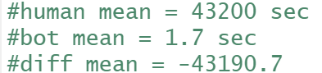
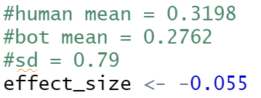

Sample Size Calculation using R
Research Question 1
=> Effect Size too large
=> Literature: n=70
Research Question 2:
=> Effect Size too small
=> n = 4089
Research Question 3
=> n = 199

Slide 21
Simulation for No Effect
Mean: 0
Standard Deviation: 1
Sample size
False Positives: Effect size > 0 & p < 0.05
True Negatives: Effect size <= 0 & p >= 0.05

Slide 22
Simulation for Expected Effect
Mean
Standard Deviation
Sample size
False Negatives: Effect size > True Effect Size & p >= 0.05
True Positives: Effect size > True Effect Size & p < 0.05

Slide 23
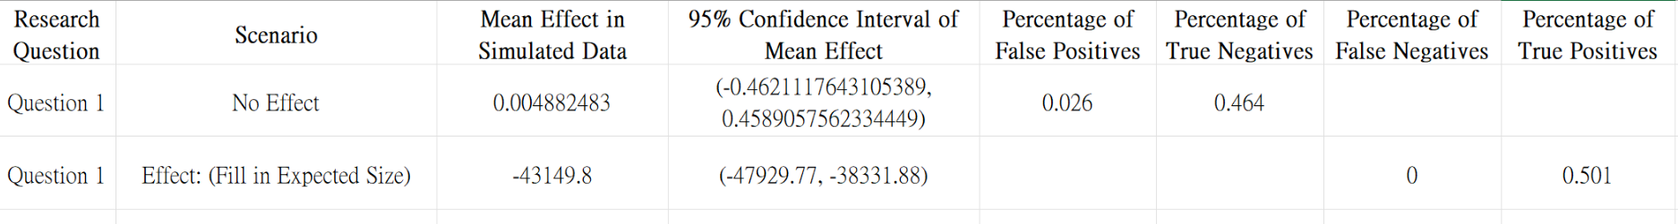
Research Question 1 Results:
Limited to detect No-effect
Larger than our Effect Size: -21600
=> Reject null hypothesis!!

Slide 24
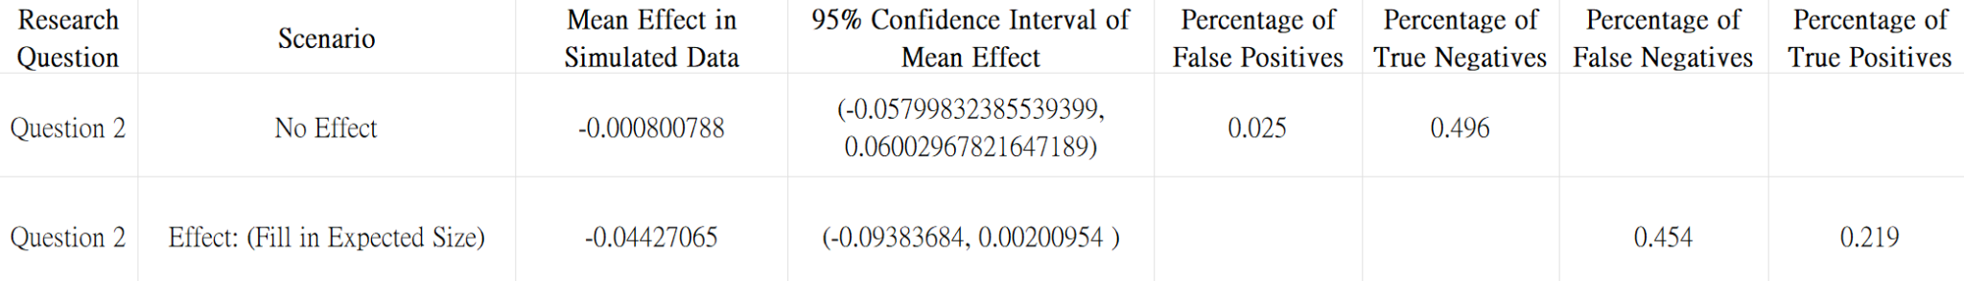
Research Question 2 Results:
Moederate but still limited to detect No-effect
Larger than our Effect Size: -0.05
Confidence interval includes 0
High FN&LowTP
=> Further investigation !!

Slide 25
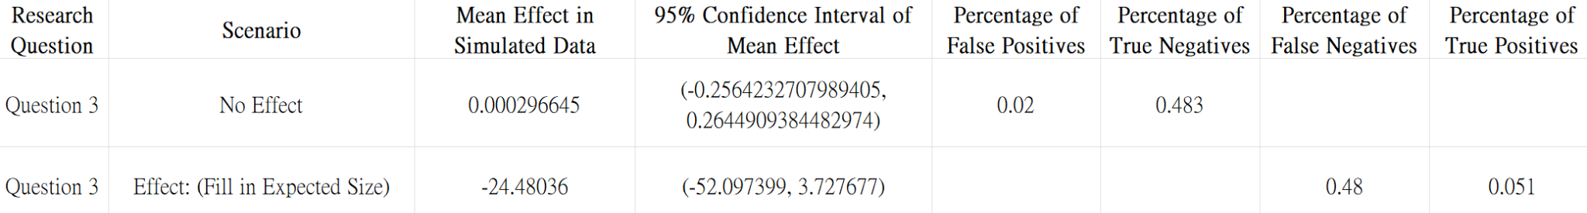
Research Question 3 Results:
Moederate but still limited to detect No-effect
Larger than our Effect Size: -20
Confidence interval includes 0
High FN&LowTP
=> Further investigation !!

Slide 26
Thank You

